Slide 1

MongoDB

Slide 2
MongoDB
MongoDB is an open-source document database and leading NoSQL database. MongoDB is written in C++. This tutorial will give you great understanding on MongoDB concepts needed to create and deploy a highly scalable and performance-oriented database.

Slide 3
Why Use MongoDB?
Document Oriented Storage − Data is stored in the form of JSON style documents.
Index on any attribute
Replication and high availability
Auto-Sharding
Rich queries
Fast in-place updates
Professional support by MongoDB

Slide 4
Where to Use MongoDB?
Big Data
Content Management and Delivery
Mobile and Social Infrastructure
User Data Management
Data Hub

Slide 5


Installation

Slide 6
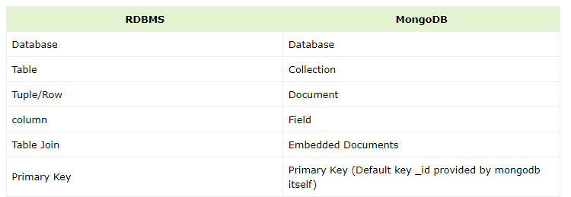
RDBMS VS MongoDB

Slide 7
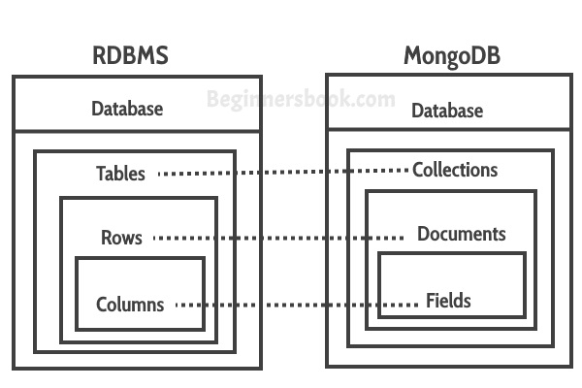
Term to Know

Slide 8
Chapter1
How to Show Databases
How to Create Database & Delete.
How to Create Collection & Document.
How to check Current Database.
How to show Collections.
How to show Documents.

Slide 9
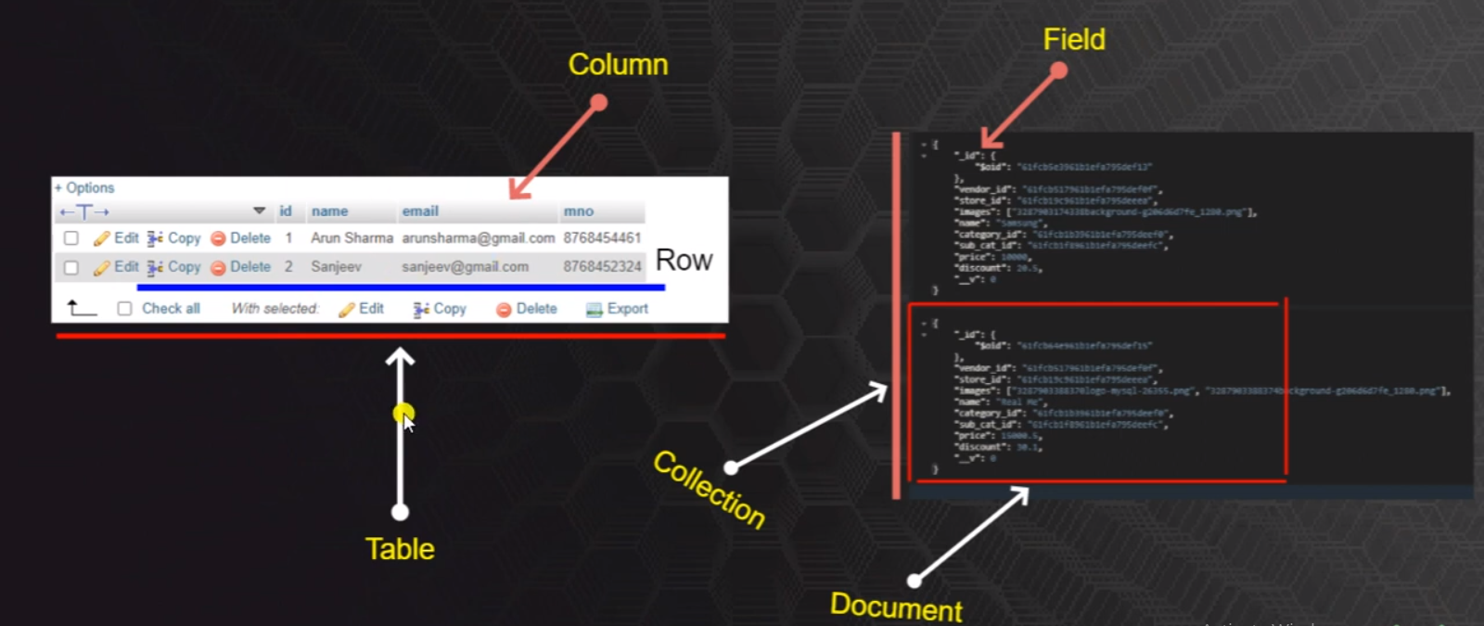
MySQL
mongo

Slide 10
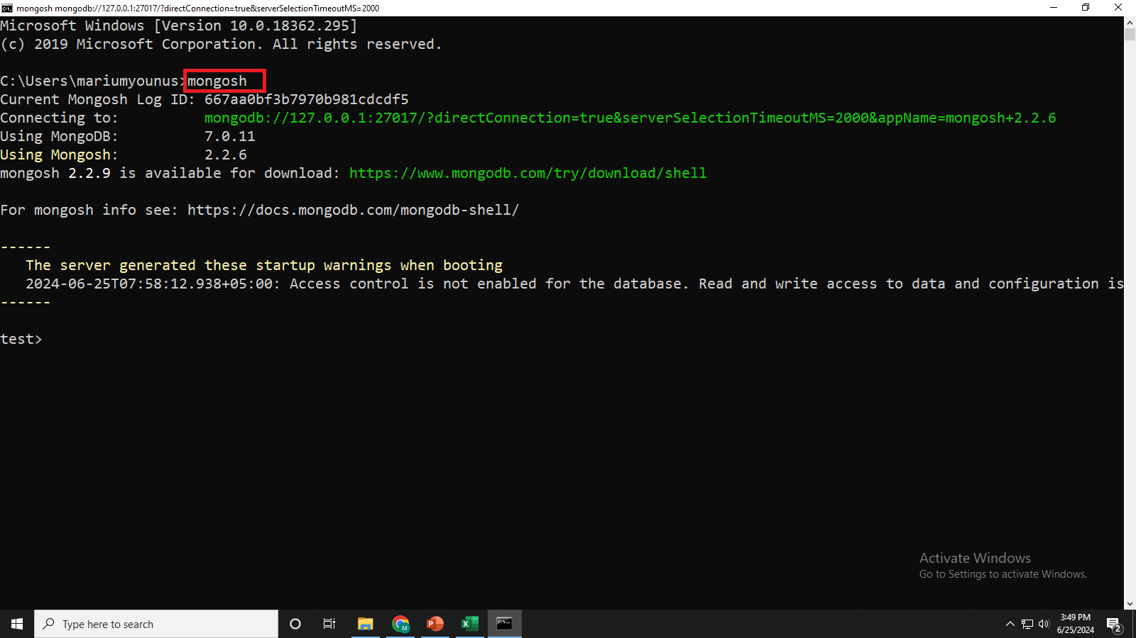
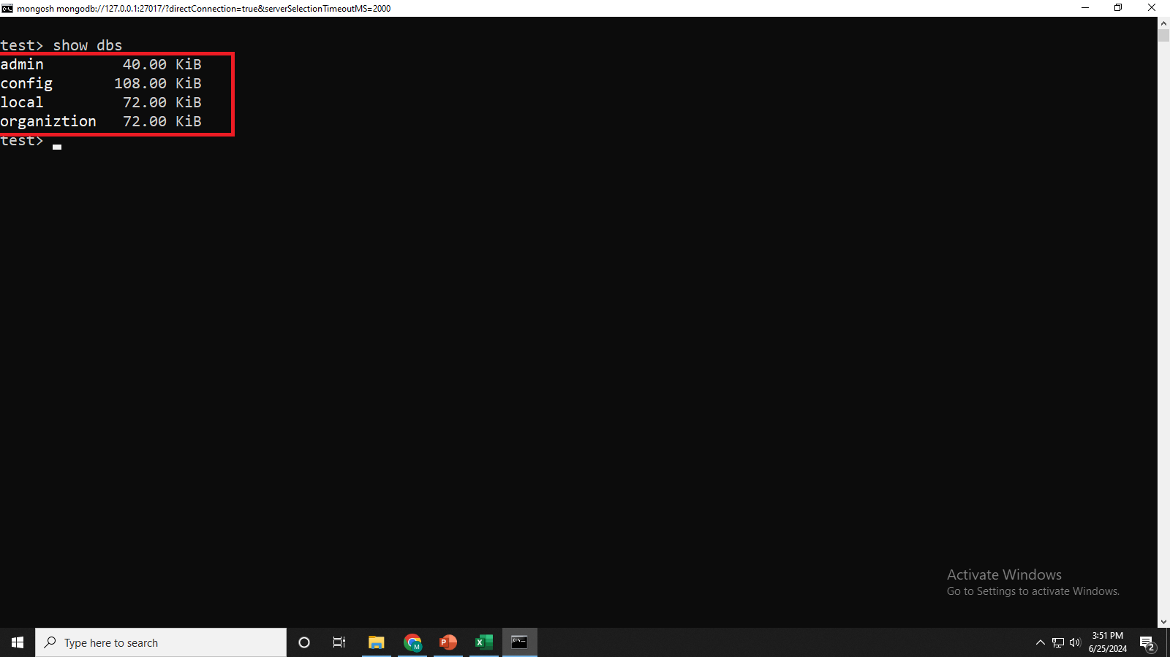
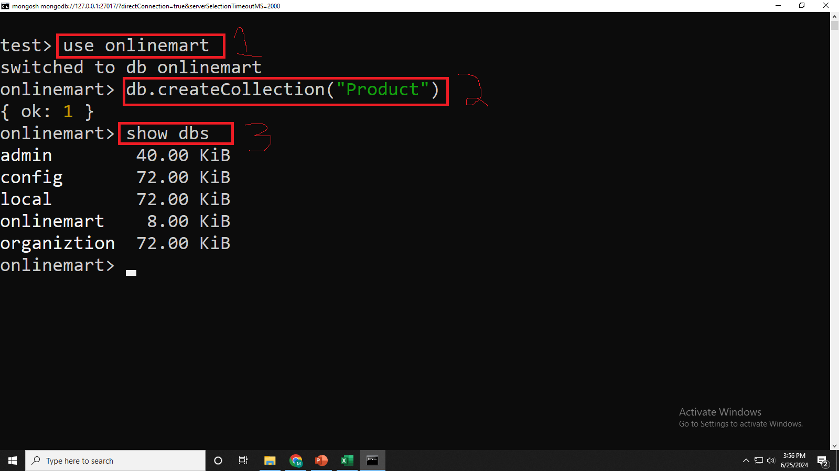
Mongosh

Slide 11
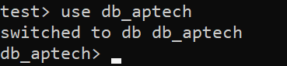
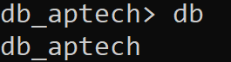
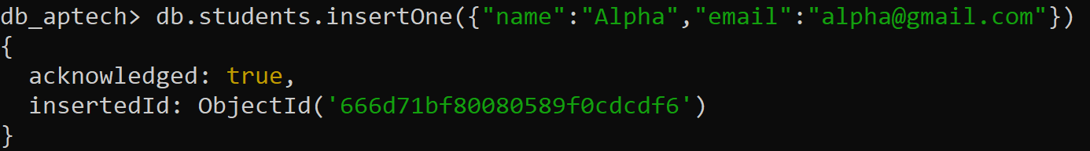
How to Create Database
Current database check
One Collection and one document is present so the database is create

Slide 12
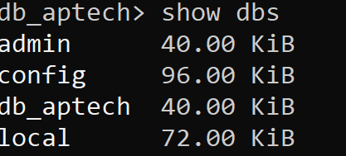
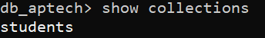
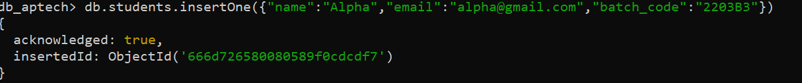
How to Show Databases
Show Collection in DB
If you want more fields in collection after so you can add it easily

Slide 13
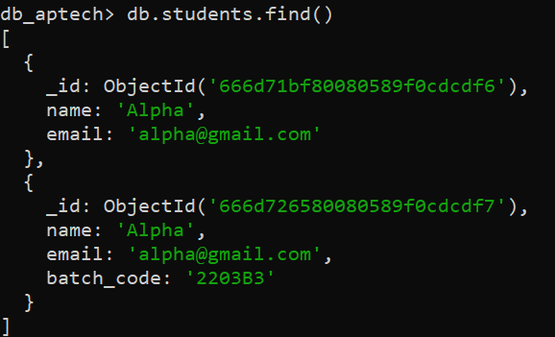
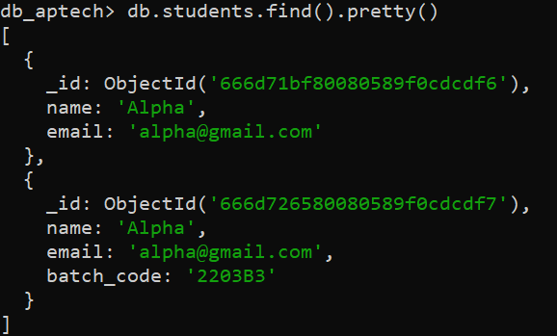
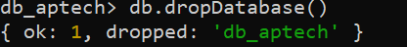
Show All Records
Show All Records in Pretty Format
Delete Database Command
Note Make Sure you have to present on that database which you want to delete
Command “use database_name” then drop it

Slide 14
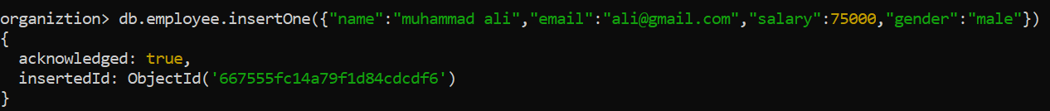
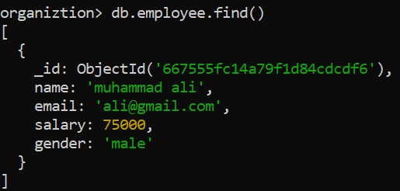
Insert Operation with Insert One & Insert Many
insertOne

Slide 15
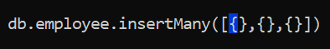
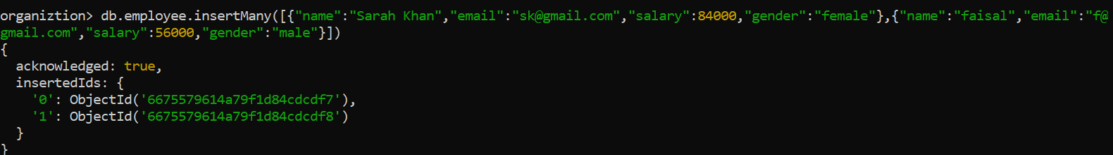
Insert Operation with Insert One & Insert Many
insertMany

Slide 16
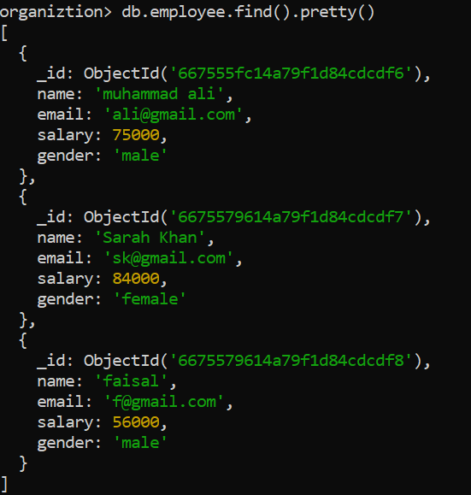

Slide 17
Chapter 2 (CRUD -------- READ)
db.collection.find(query,projection)
Find all results to collection.
Show result in pretty format
Show particular document.
Show particular field in one document.
Show particular field in one document without ID.
Set the query to “qty:3” and get only one document.
Apply on 6 Question and skip 1 document and get next result.
Use another method for 6 question and get result.

Slide 18
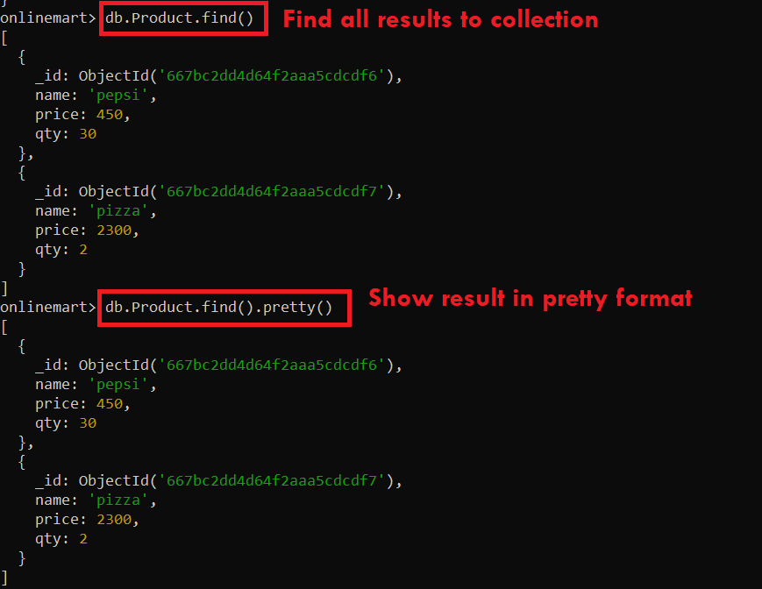

Slide 19
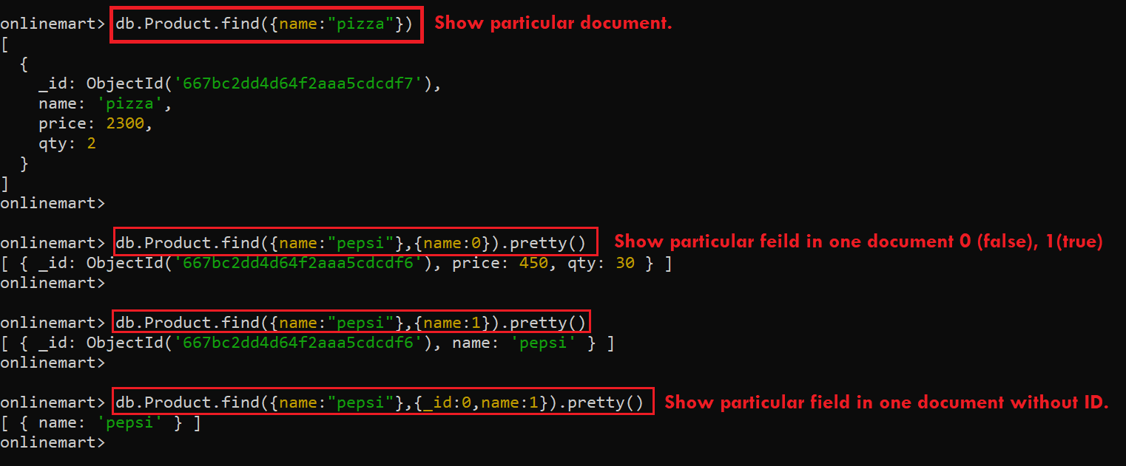

Slide 20
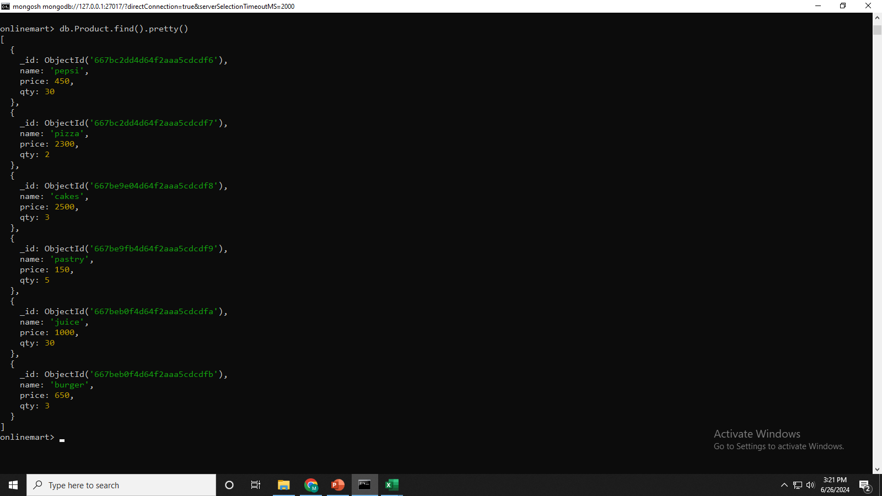
All records in product table

Slide 21
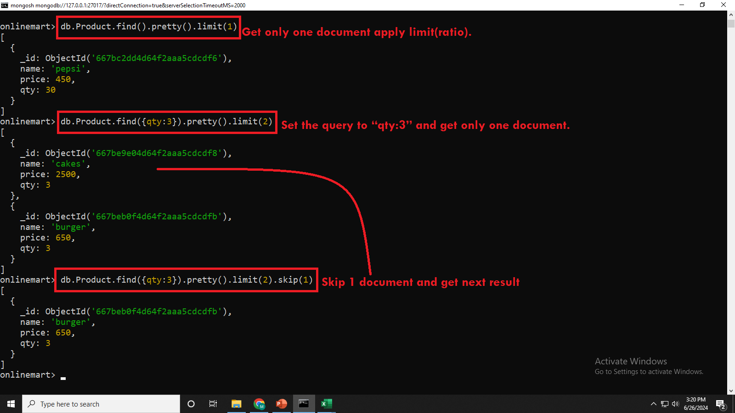
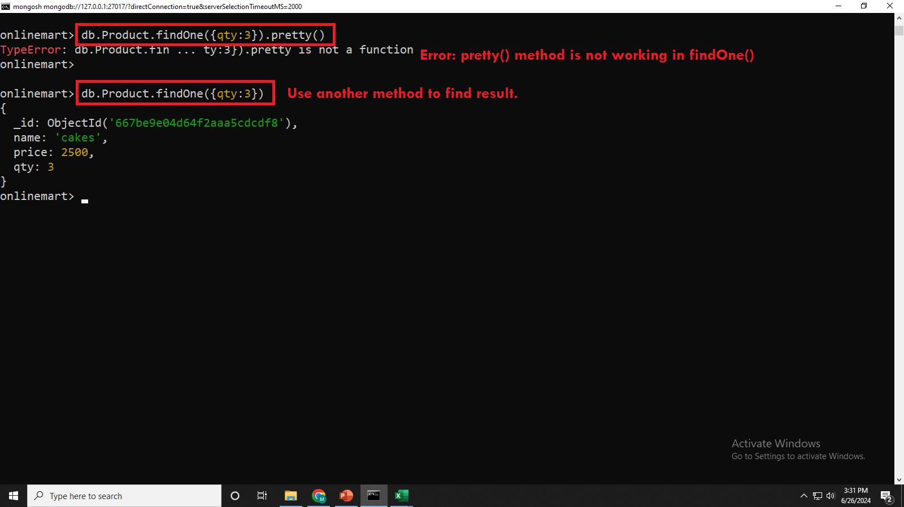

Slide 22
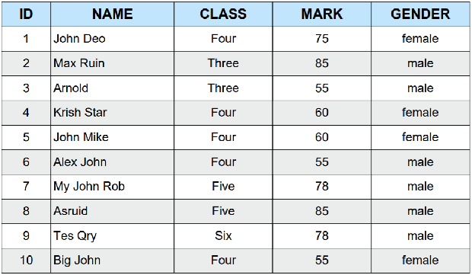
Task
Find all results to collection.
Show result in pretty format
Show particular document.
Show particular field in one document.
Show particular field in one document without ID.
Set the query to “gender:male” and get only one document.
Apply on 6 Question and skip 1 document and get next result.
Use another method for 6 question and get result.

Slide 23
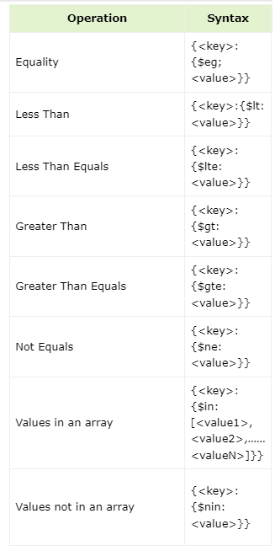
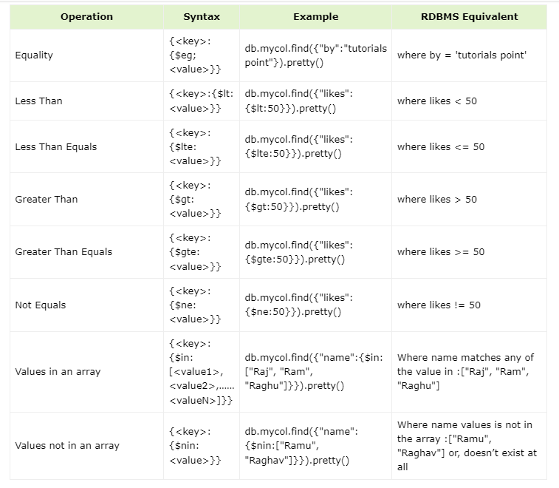

Slide 24
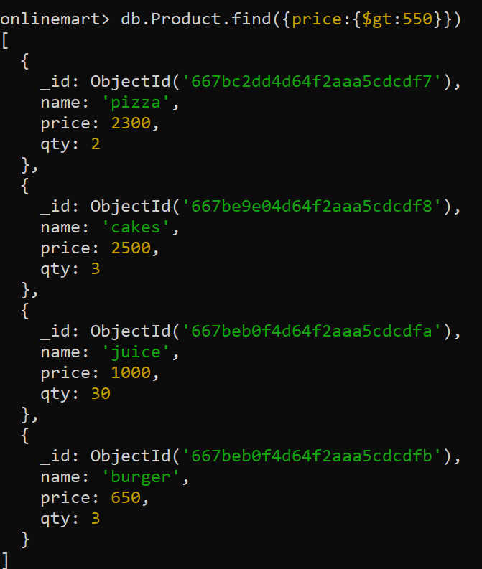
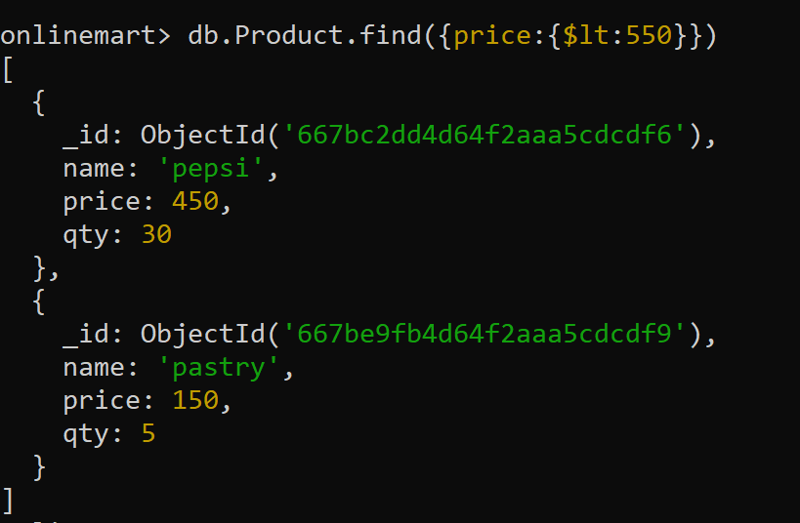
Less Then
greater Then

Slide 25
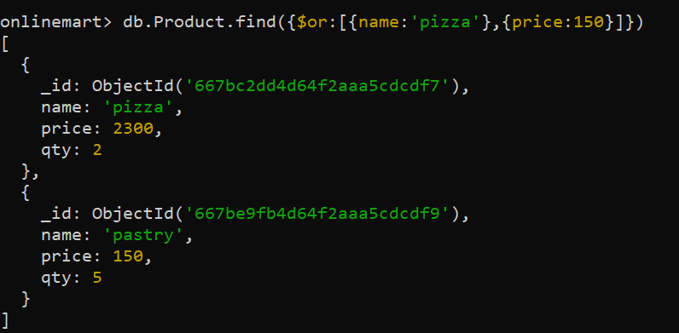
Or

Slide 26
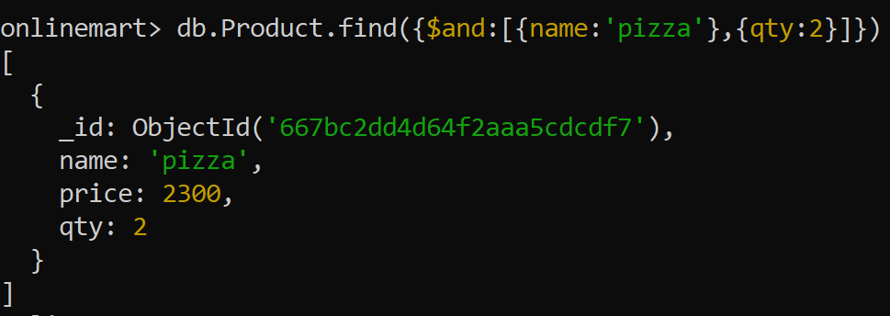
AND

Slide 27
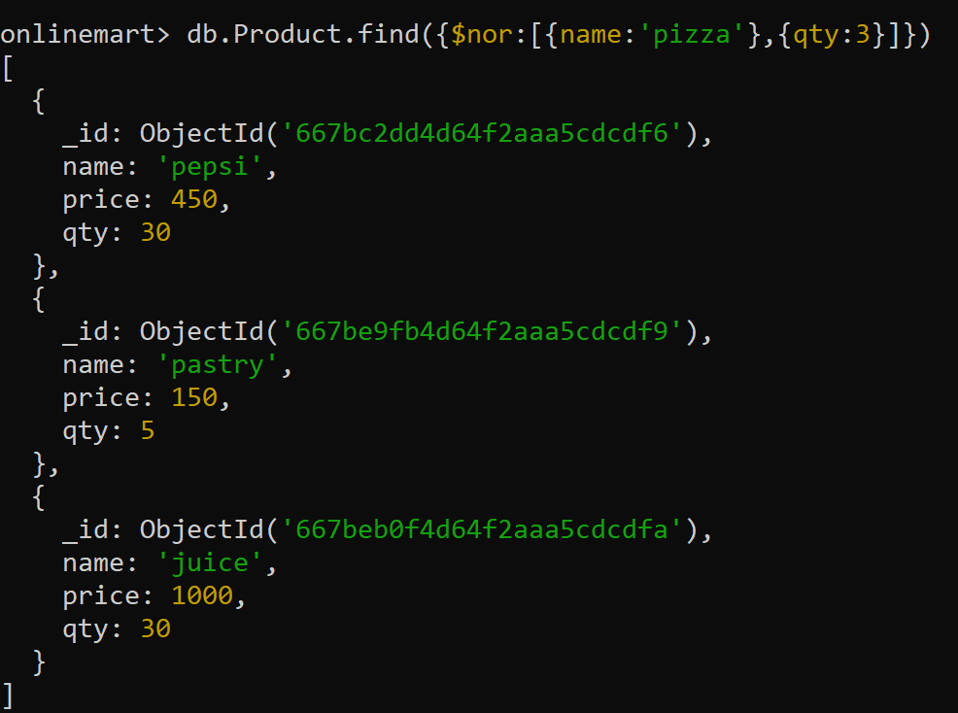
NOR

Slide 28
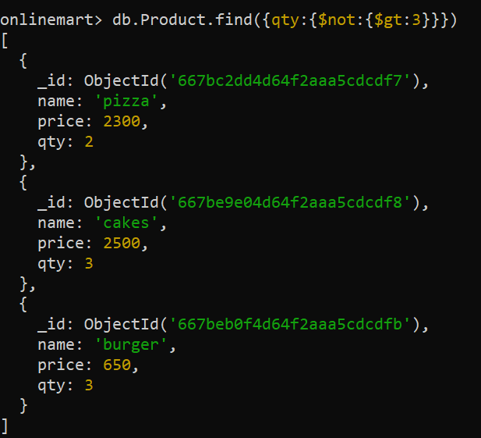
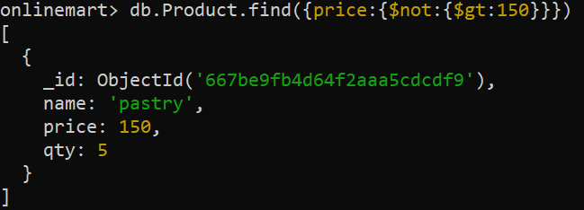
Not greater then

Slide 29
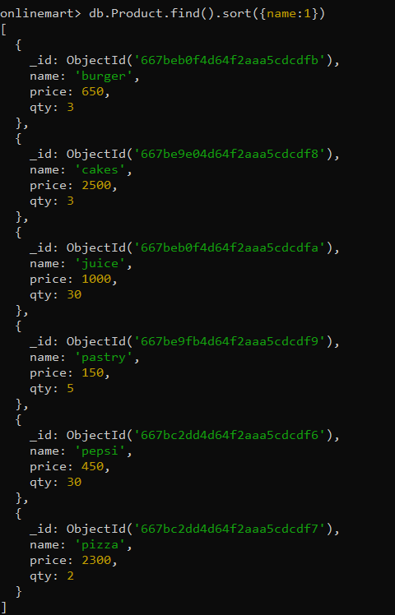
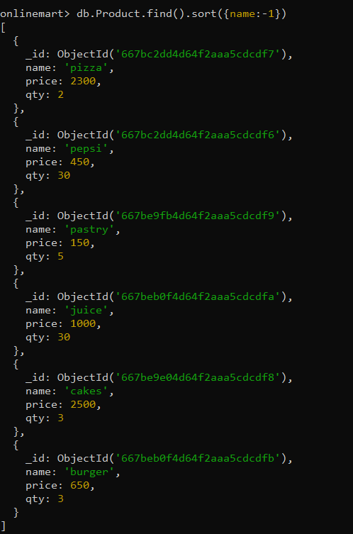
Sort -1 (DESC)
Sort 1 -1 (ASC)

Slide 30
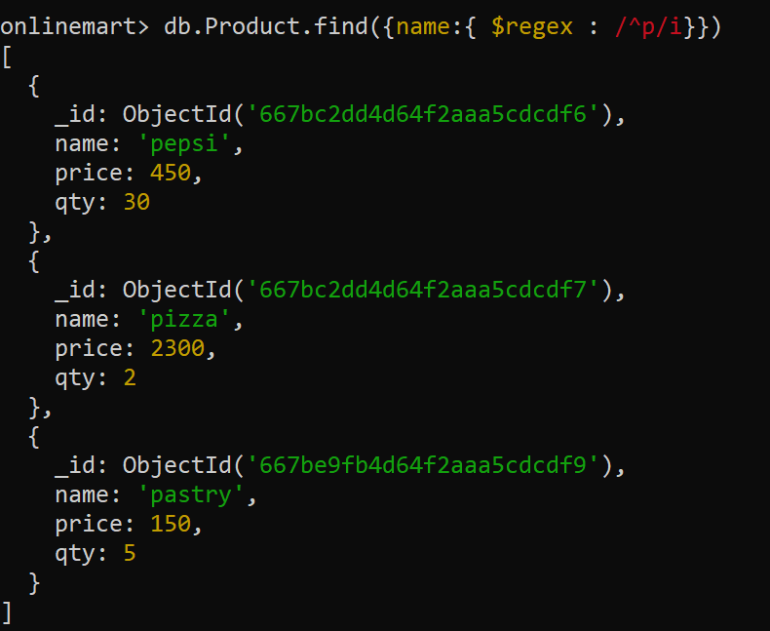
Regular expression

Slide 31
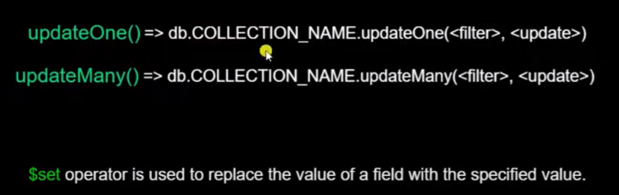
Chapter # 03 (CRUD -------- Update)
How to update one particular field in one document.
How to update one particular field in two or more document.
How to update more then one field in one document.
How to update more then one field in two or more document.

Slide 32
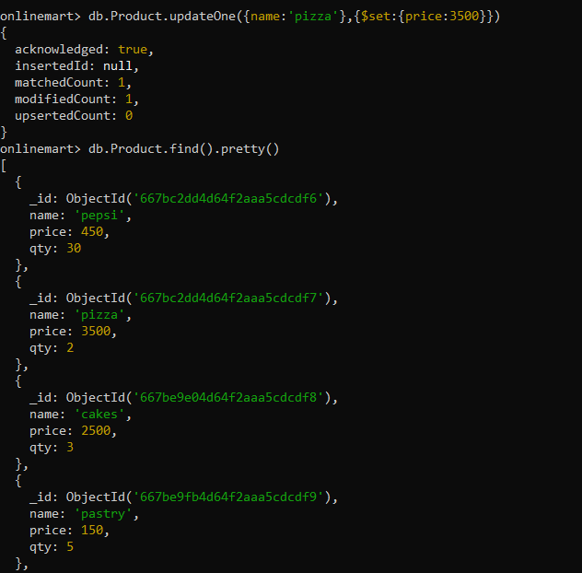
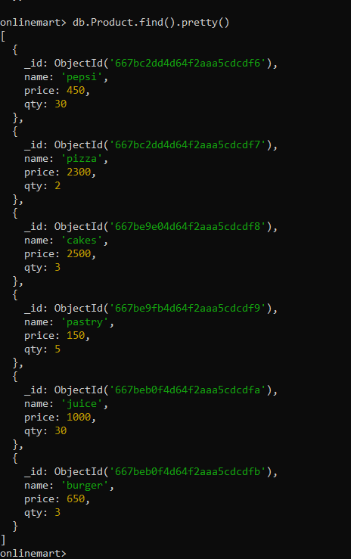
Before update
After update
How to update one particular field in one document.

Slide 33
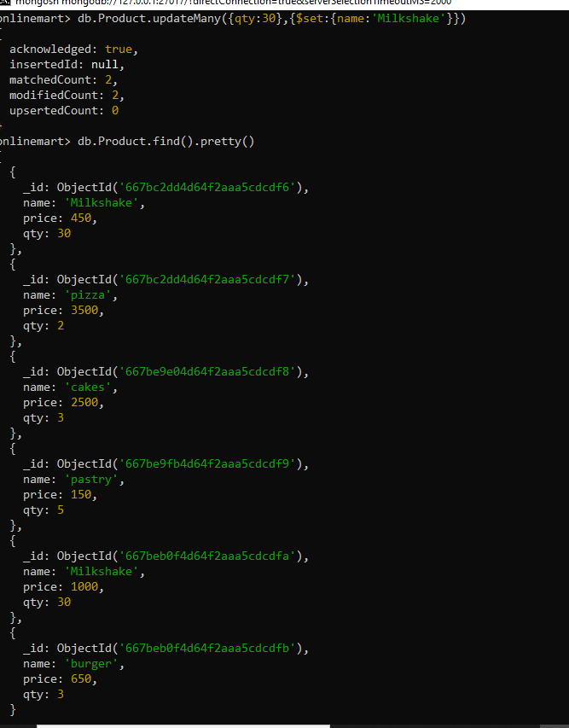
Before update
2. How to update one particular field in two or more document.
After update

Slide 34
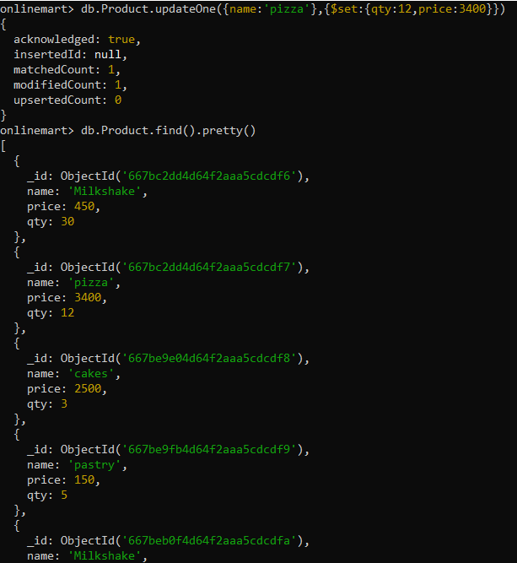
Before update
After update
3. How to update more then one field in one document.

Slide 35
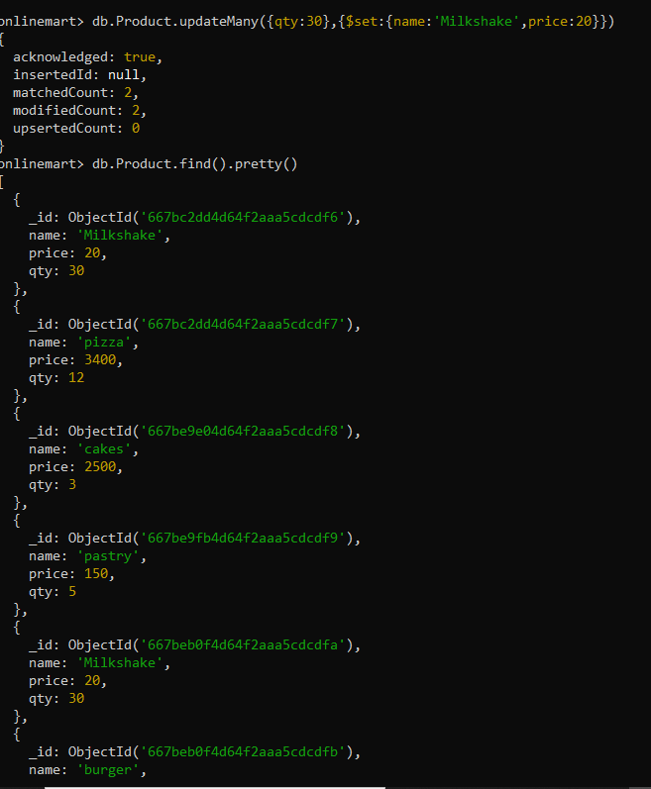
Before update
After update
4. How to update more then one field in two or more document.

Slide 36
Delete For Mongodb

Slide 37
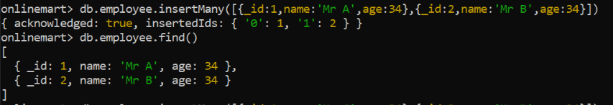
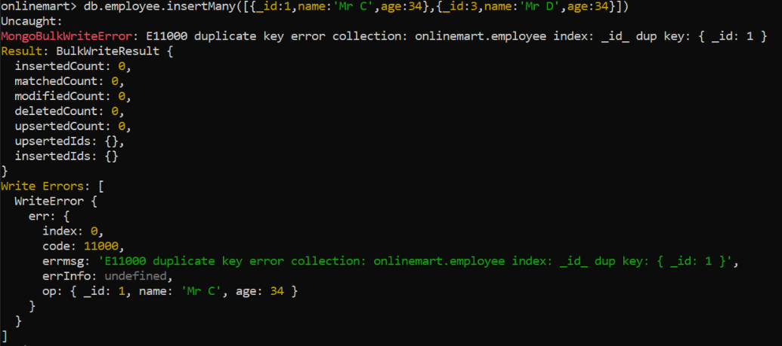
Ordered option in insert command in MongoDB

Slide 38
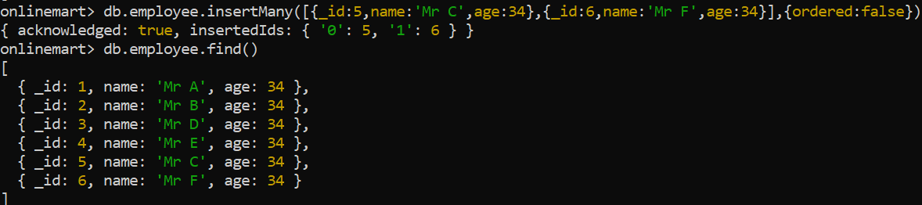

Slide 39
Schema Validation

Slide 40
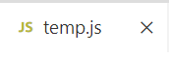
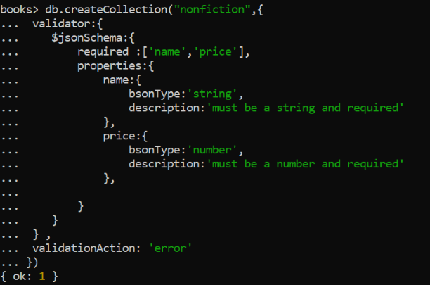
Schema Validation
db.createCollection("nonfiction",{
validator:{
$jsonSchema:{
required :['name','price'],
properties:{
name:{
bsonType:'string',
description:'must be a string and required'
},
price:{
bsonType:'number',
description:'must be a number and required'
},
}
}
} ,
validationAction: 'error'
}),

Slide 41
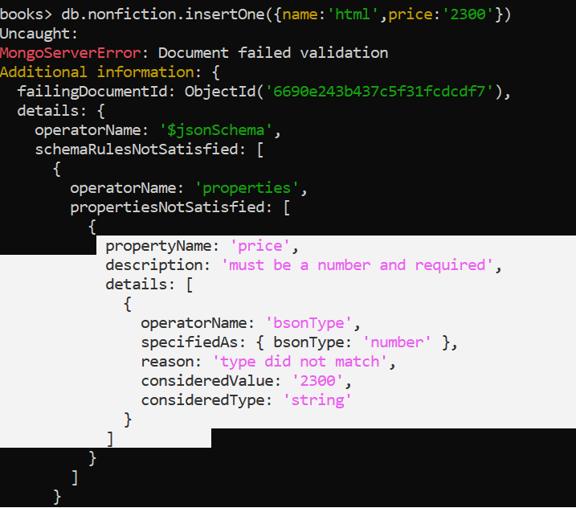

Error
Correct

Slide 42


Error
Correct

Slide 43

Use equal no. of Fields

Slide 44

Modify Validation
db.runCommand({
collMod:'nonfiction',
validator:{
$jsonSchema:{
required :['name','price','author'],
properties:{
name:{
bsonType:'string',
description:'must be a string and required'
},
price:{
bsonType:'number',
description:'must be a number and required'
},
author:{
bsonType:'array',
description:'must be an array and isrequired',
items:{
bsonType:'object',
required :['a_name','a_email'],
properties:{
a_name:{
bsonType:'string',
},
a_email:{
bsonType:'string',
}
}
}
}
}
}
}
})

Slide 45


Error
Correct

Slide 46
MongoDB Aggregation

Slide 47

Insert These Record First

Slide 48




Slide 49


$match

Slide 50


Group teacher by age

Slide 51


Group Teacher by Age and show all teacher name as per group

Slide 52




Get Full Document data

Slide 53



Give A Count per age of male teacher

Slide 54


Slide 55


Give a count per age of male students and sort them by count in desc manner

Slide 56


